Slide 1
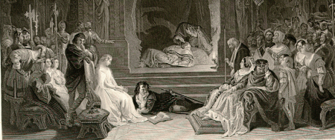
The Play-Scene in Hamlet
Painted by Daniel Maclise in 1842

Slide 2
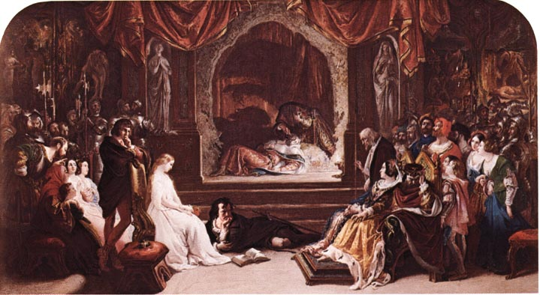

Slide 3
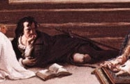
Hamlet lies in the lower part in the middle of the scene staring intently at Claudius, watching for the guilty reaction he expects, and so have his course set between action and inaction.
A book lies open before him, implying his philosophical tendencies, but also his sword is readily in view, and his body separates them, presenting him as torn between the two.

Slide 4
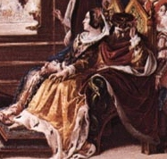
Claudius and Gertrude are shown here, Gertrude calmly watching the performance with her hands folded and her face in a state of calm.
Claudius is looking away, holding his head in one hand and his other hand is gnarled in torment.
His left hand appears to be touching the crown that he reaped after his brother’s death and his face is pinched, making his feature almost rat-like.

Slide 5

Horatio stands in the left hand off from the direct action of the scene.
As per Hamlet’s instructions, he is watching Claudius for the start of a guilty man.
With his hand to his face (similar to the stance of Rodin’s The Thinker) he is pensively watching, employing his academic reason to the judgment of the situation.

Slide 6

Ophelia, dressed in a virginal white with her head demurely bowed , is apart from the scene of darkness and anxious chaos. She seems to be the one pure and unaffected thing. She could even possibly be looking down at Hamlet, the man she loves and who has just rejected her a scene earlier.
In her hand she appears to hold a flower (from the color I might say a poppy or a rose– although neither of those are used in her later scene). This flower foreshadows her mad scene that comes in the next act when she distributes meaningful flowers to Claudius, Gertrude, and Laertes.

Slide 7

Polonious, looking particularly haggard and intent, watches the play with a slight smile.
He is still convinced that Hamlet is mad for love of Ophelia, and is here captured in defiant defeat as he understands by way of the play that Hamlet’s troubles run deeper than simple lust.

Slide 8
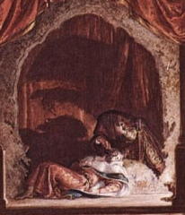
The most interesting part of this painting is the center of the picture where the stage is. In the foreground the character of the play-with-in-the-play, Lucianus (the murderer) is pouring poison into sleeping player king Gonzago’s ear (the same way Claudius killed King Hamlet). However, it is the shadow which the actors cast which is the most fascinating part of the entire piece because you can clearly see the figure of Lucianus is a rat.
This play is called The Mousetrap and it is meant to catch the conscience of the King , thus it is fitting that he actor portraying the murder is bestially marked in this kind of shadow puppetry on the wall (kind of another play-within-a-play-within-a-play).
Tidbit: Lucianus comes from the Lucius meaning light, thus this character sheds light on the truth. (The devil, Lucifer also shares a similar root, implying the evil of the character.)

Slide 9
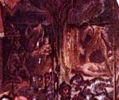
To the right hand side of the painting are murals on the walls, above the heads of the audience soldiers. The mural on the far right evidently is Cain looking over the body of his brother, Able, whom he has just killed.
The panel on the left is harder to make out,. There is definitely a baby and a man bowing before the baby. This may be the visitation of the Magi , but because I cannot get a clearer image I cannot say for sure.

Slide 10
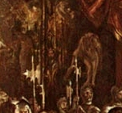
The mural on the left hand side of the painting appears to be Adam and Eve being expelled from the Garden of Eden. On the far left hand panel I can make out a naked female figure and a man’s bearded face, but that’s about it. (Darn, why doesn’t the CSI enhance program come with Microsoft Office?!)

Slide 11


These two statues bookend either side of the stage. The one on the left has her hands folded in prayer and contemplation, as the other has her hand over her heart and holds a sword in front of her body. The first represents thought, innocence and thus forgiveness and the second figure represents justice and violence as directed by the emotions (implied by the hand over the heart). These two figures flank the stage, thus the play is the decision maker in which statue will come to life afterwards– and by this I mean which ideal with be realized in the action of Hamlet’s body.

